Slide 1
Team Vasco da Gama
Twitter Feed Analysis using Amazon Comprehend
Prithvi Mallepula
Scott McClellan
Syed Hassan
Wesley Hediger

Slide 2
Business Case
We believe that banking product owners need a better way to get a comprehensive understanding of their product’s public opinion, because surveys do not always reveal the customers true opinion.
We believe that if we help them solve this problem, we will be able to deliver better insights into what aspects of the product/business can be improved upon.
Companies will know that they are on the right track, when they start seeing an improved sentiment score for the opinions over time.

Slide 3
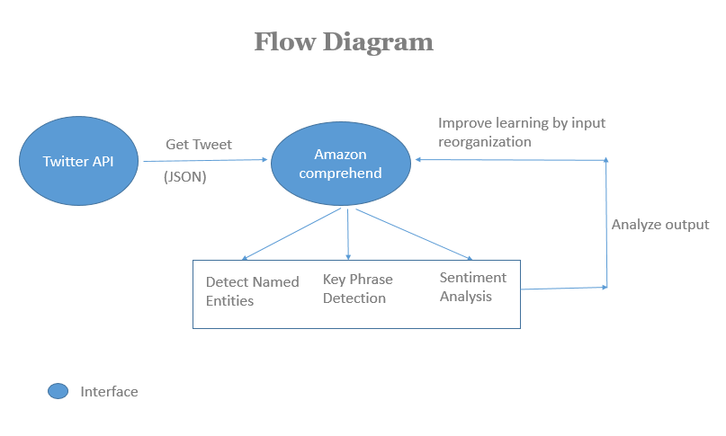
Solution Overview
Using Twitters API to get tweets with a banking # and feeding the tweets into Amazon Comprehend to perform the following:
By identifying key phrases, the most discussed topics can be detected and topic modelling performed
Sentiment analysis to gauge the mood of the content
After we identify the relevant topics, we will able to organize a knowledge base of tweets modeled around these topics.

Slide 4
Benefits and limitation
Benefits:
-Find out what customers care about
-Find out how customers feel about certain products
-Group Similar Topic tweets together
Limitations:
Since we are only limited to twitter, we would not get a comprehensive analysis from other social media platforms
Since enterprise level access is required to pull more than 25 Tweets, current data set is not large enough to gain useful insights.

